Slide 1


Data Structure
Dr Shahjad
Faculty
School of Engineering & Technology
K.R. Mangalam University
Unit 4 : Sorting and Searching
Dr Shahjad

Slide 2

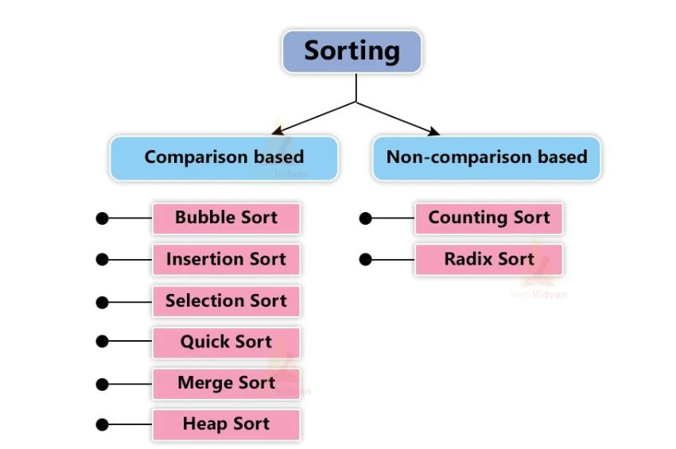

Types of Sorting
Source : https://techvidvan.com/tutorials/wp- content/uploads/sites/2/2021/06/TechVidvan-Bubble-sort- normal-image01.jpg.

Slide 3
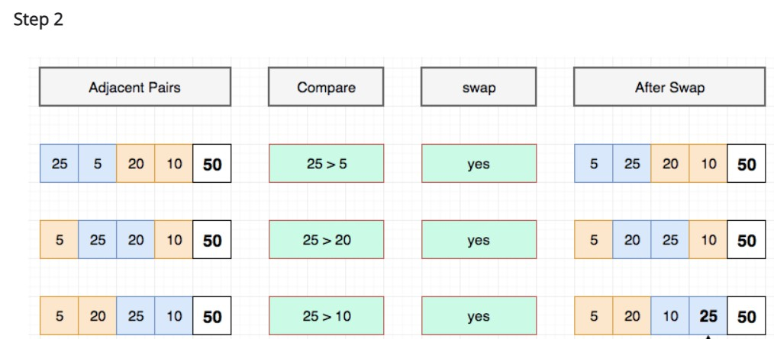
Example of Bubble Sort

Slide 4
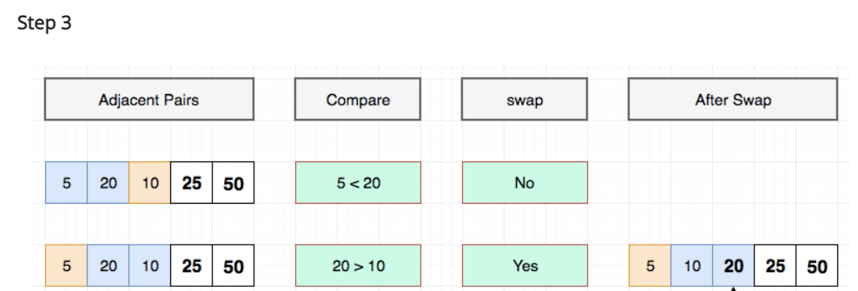
Example of Bubble Sort

Slide 5
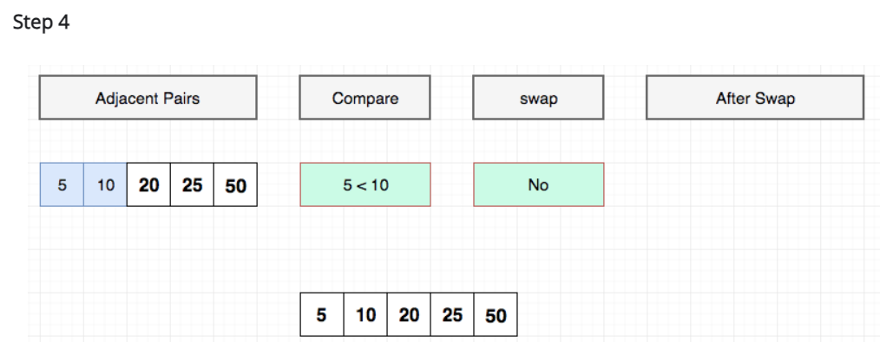
Example of Bubble Sort

Slide 6
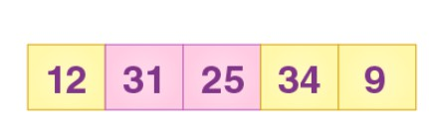
Exercise : Bubble Sort
Sort the following Array using Bubble Sort

Slide 7
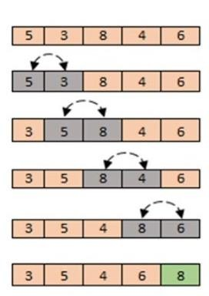
Bubble Sort Algorithm
declare variables i, j
loop : i = 0 to n – 1 // outer loop
loop : j = 0 to n -i- 1 // inner loop
if ( a[j]>a[j+1] ) then
– swap a[j] & a[j+1]
end loop // inner loop
end loop // outer loop

Slide 8
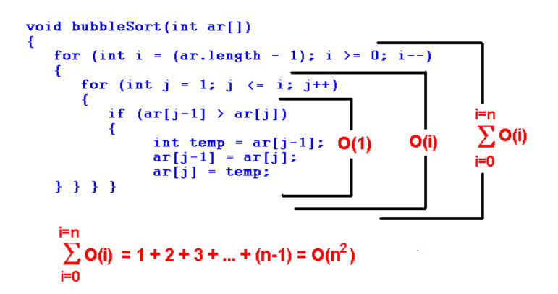
Bubble Sort Algorithm Complexity Analysis

Slide 9
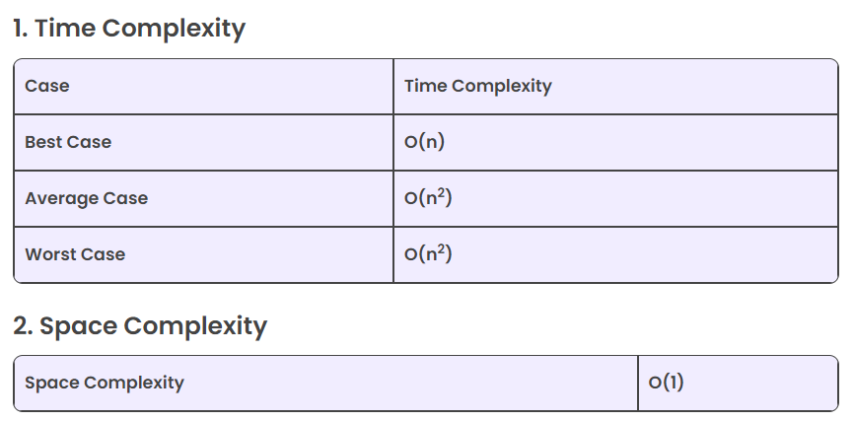
Bubble Sort Algorithm Complexity Analysis

Slide 10
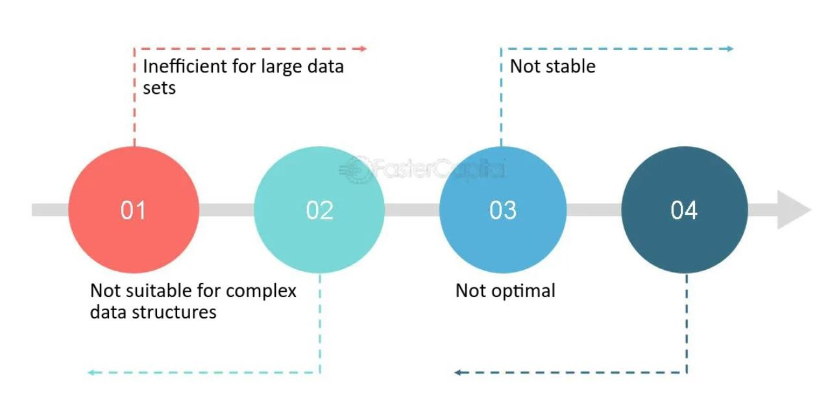
Advantages and Disadvantages
Bubble Sort

Slide 11
Test Your Knowledge
Q1 Which of the following sorting algorithms performs poorly on large datasets?
Bubble Sort
Quick Sort
Merge Sort
Heap Sort
Answer (A)
Q2 What will be the recurrence relation of the code of recursive bubble sort?
T(n) = 2T(n/2) + n
T(n) = 2T(n/2) + c
T(n) = T(n-1) + n
T(n) = T(n-1) + c
Answer (C)

Slide 12
Test Your Knowledge
Q1 What is the average case time complexity of bubble sort?
Q2 What are the number of swaps required to sort the array arr={1, 2, 4, 3, 7, 5, 6} using recursive bubble sort?

Slide 13
Test Your Knowledge
Q3 What will be the base case for the code of recursive bubble sort?
If (n<1)
Return
If (n==0)
Return
If (n==1)
Return
If (n==2) Return

Slide 14
REVIEW
Sorting data allows a user to find information faster and easier.
Bubble Sort is the simplest sorting algorithm that works by repeatedly swapping the adjacent elements if they are in wrong order.

Slide 15
References
https://www.hackerearth.com/practice/algorithms/sorting/bubble-sort/tutorial/
https://www.freecodecamp.org/news/most-asked-questions-about-bubble-sort/
https://www.scholarhat.com/tutorial/datastructures/bubble-sort-in-data-structures
https://www.scaler.com/topics/data-structures/bubble-sort/
https://visualgo.net/en/sorting
https://www.youtube.com/watch?v=9I2oOAr2okY
Dr. Swati, Ms Suman & Ms Neetu

Slide 16

THANK YOU

